Slide 1
HISTORICAL PRICE INSIGHTS
FINAL YEAR PROJECT
Presentation by:
Jatin (20EBKCS052)
Anjali Sharma (20EBKCS011)

Slide 2

PROBLEM STATEMENT
In the fast-paced world of commodity trading, timely and accurate data is crucial. Prices of commodities like oil, gold, and wheat fluctuate rapidly due to market demand, political events, currency changes, and natural disasters.
Traders and analysts need reliable historical data to identify patterns, forecast prices, and make informed trading decisions. Ensuring this data is accurate, complete, and readily available is essential for making the best decisions in the market.

Slide 3
ABOUT
Objective
Develop a web scraper to collect commodity price history from the target website, indexmundi
Significance of Commodity Price Data
Finance: Helps in investment decisions and risk management.
Economics: Provides insights into market trends and economic indicators.
Supply Chain Management: Assists in forecasting and managing supply chain risks.

Slide 4



Technologies Used
Versatile scripting language
Utilized for web scraping and data manipulation
Key libraries: Selenium, BeautifulSoup
Manages browser interactions
Retrieves data from dynamic web pages
Parses HTML content
Efficiently extracts relevant data

Slide 5



NoSQL database known for flexibility and scalability
Flexible data storage
Scalable to handle growing data volumes
Lightweight web framework
Allows for quick development of web applications
Integrates well with Python code, simplifying backend to UI connection
Enhances user experience
Responsiveness: Adjusts to different screen sizes and devices
Offers pre-built styles and components for a user-friendly interface

Slide 6

WORKFLOW
Web Scraping
Data Cleaning and
Transformation
Data Storage (MongoDB)
Web Application
Development
(Flask, Bootstrap)
User Interface and
Data Visualization
Testing & Troubleshoot

Slide 7

with Python
Target Website Selection (IndexMundi)
Reasons for Selection:
Data Relevance: Comprehensive and up-to-date commodity price data.
Data Quality: Sourced from reputable international organizations and government agencies.
Website Structure: Well-organized and easy to navigate.
Legal Considerations: Terms of service allow non-commercial web scraping with guidelines.

Slide 8
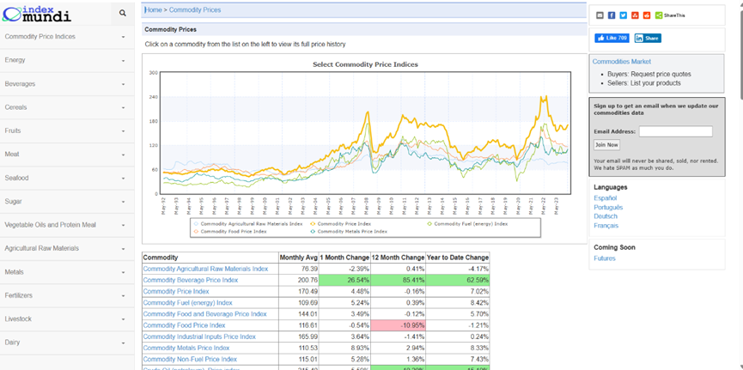
Website to be Scraped

Slide 9
Extracting Price Data Using BeautifulSoup
Import Libraries: Import BeautifulSoup and requests.
Send HTTP Request: Use requests to get HTML content.
Parse HTML: Create BeautifulSoup object.
Locate Data: Use BeautifulSoup methods to find relevant HTML elements.
Extract Data: Get desired data from elements.
Store/Process: Save or process data accordingly.

Slide 10
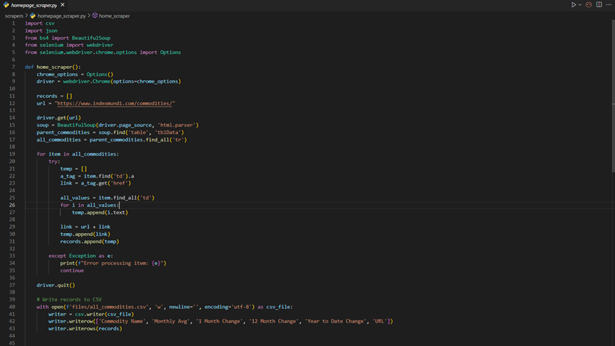
Scrapper code

Slide 11
Error Handling
Exception Handling: Use try-except blocks to catch specific exceptions like network issues or timeouts.
Retry Mechanisms: Implement retries for temporary failures or network issues.
Logging: Incorporate logging to record errors and warnings for troubleshooting.
Graceful Termination: Ensure the process ends smoothly and releases resources in case of errors.

Slide 12
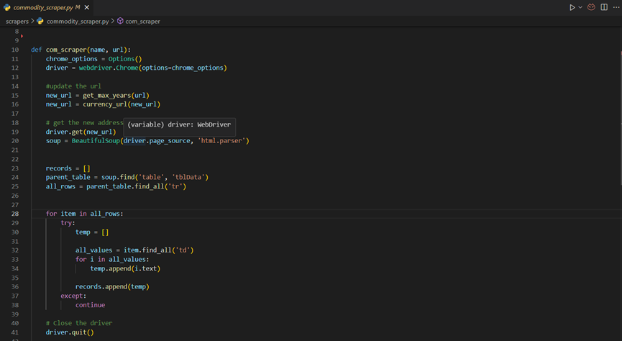
Scraper with error handling

Slide 13

Data Cleaning
Utilized Pandas for data cleaning and data manipulation
Data Cleaning: removal of duplicates and irrelevant entries.
Data Manipulation: manipulate and transform data for analysis.

Slide 14
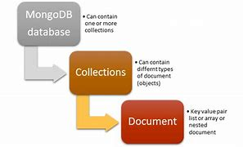
Data Storage with MongoDB
CSV Data: Input data sourced from CSV files.
MongoDB Connection: Establish connection to MongoDB instance.
Data Transformation: Convert CSV data into JSON-like documents.
Insertion: Use MongoDB's insert methods to store data in collections.
Benefits:
Flexibility: MongoDB accommodates various data formats, including CSV.
Scalability: Scalable storage solution for large datasets.
Efficiency: Efficiently stores CSV data, ensuring accessibility and integrity.

Slide 15
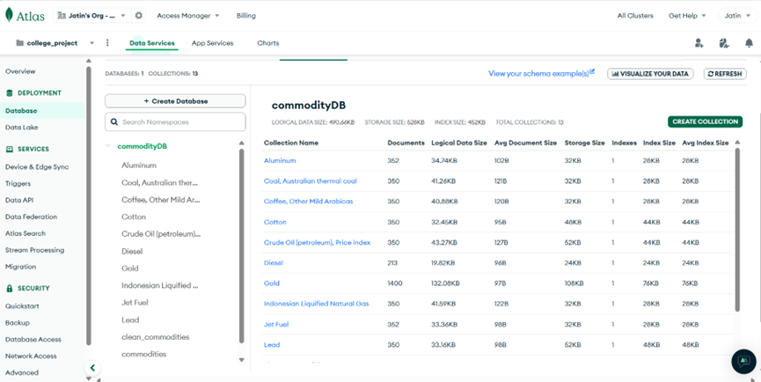
MongoDB Collections

Slide 16
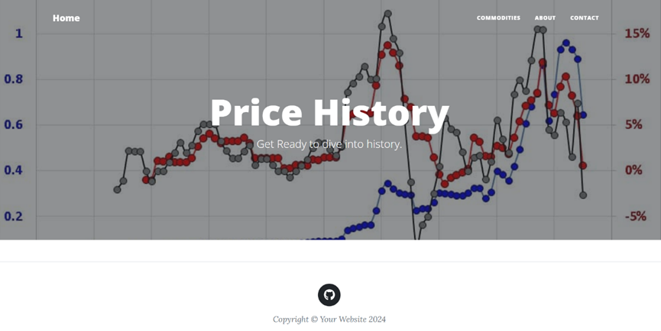
Home Page

Slide 17
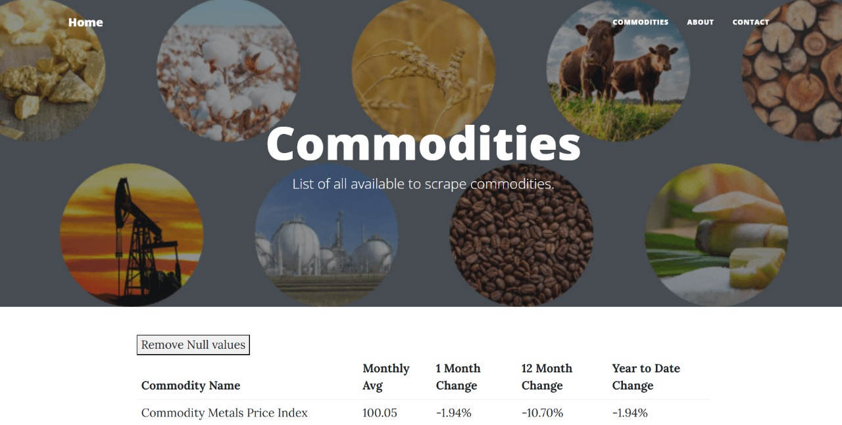
Commodities HomePage

Slide 18
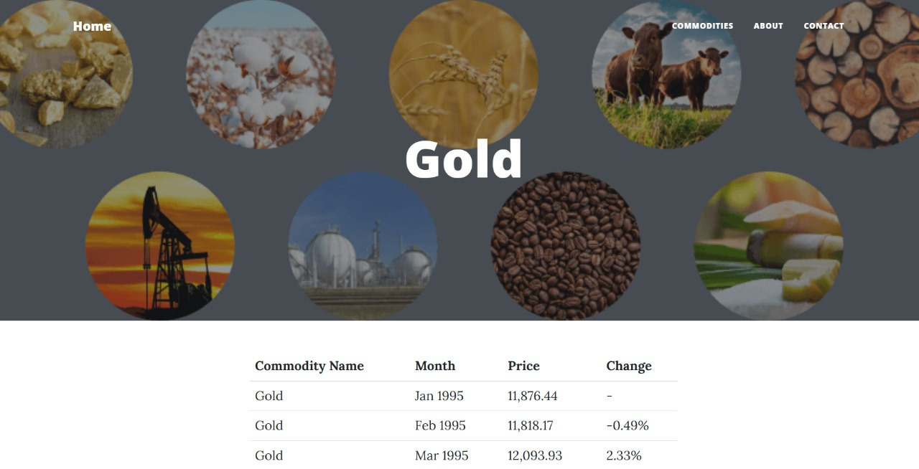
Outcome Example of the Project
Specific Commodity View

Slide 19
Thank You

